Slide 1
AI in Mathematics
Lecture 2
Classic ML. Part 1.
Bar-Ilan University
Nebius Academy | Stevens Institute of Technology
March 25, 2025

Slide 2
About This Course
1 week: Intro
2 weeks: Classic ML
2 weeks: Deep Learning in Mathematics
3 weeks: Math as an NLP problem (LLMs etc.)
3 weeks: Reinforcement Learning (RL) in Math
1 week: Advanced AI topics
1 week: Project Presentations

Slide 3
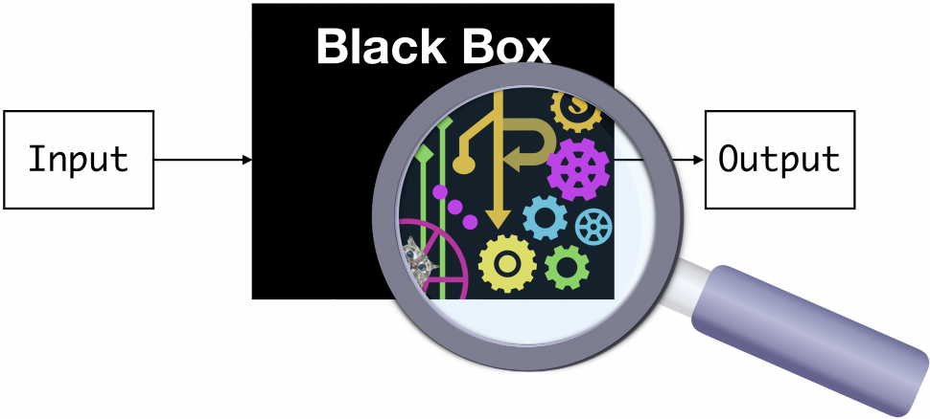
Machine Learning

Slide 4
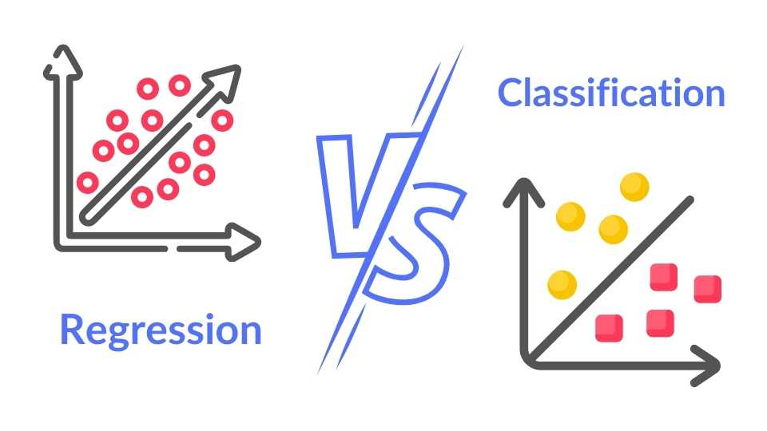
Regression and Classification

Slide 5
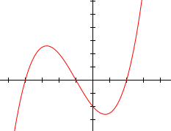
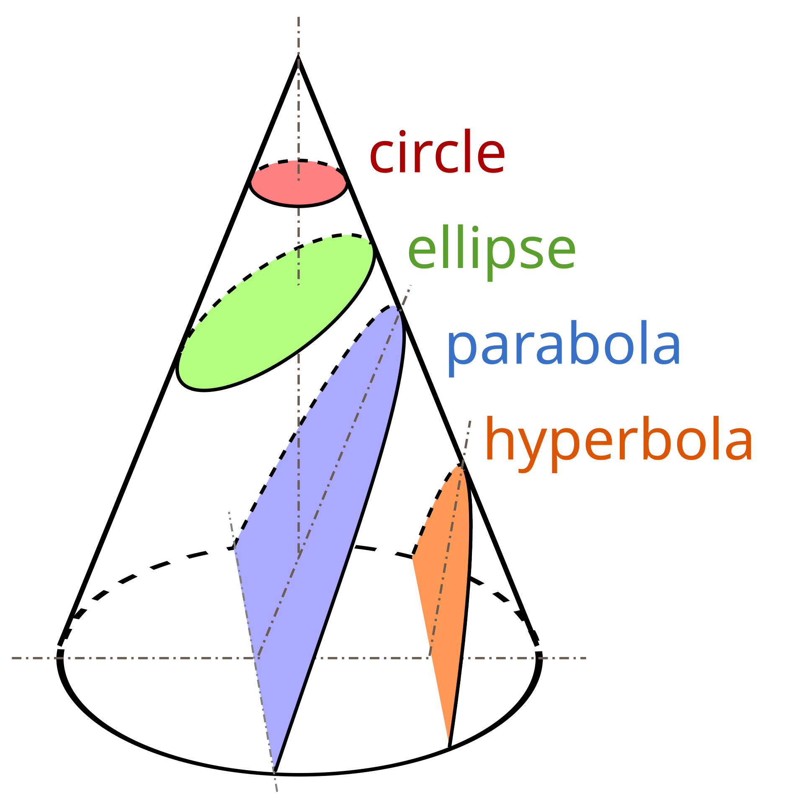
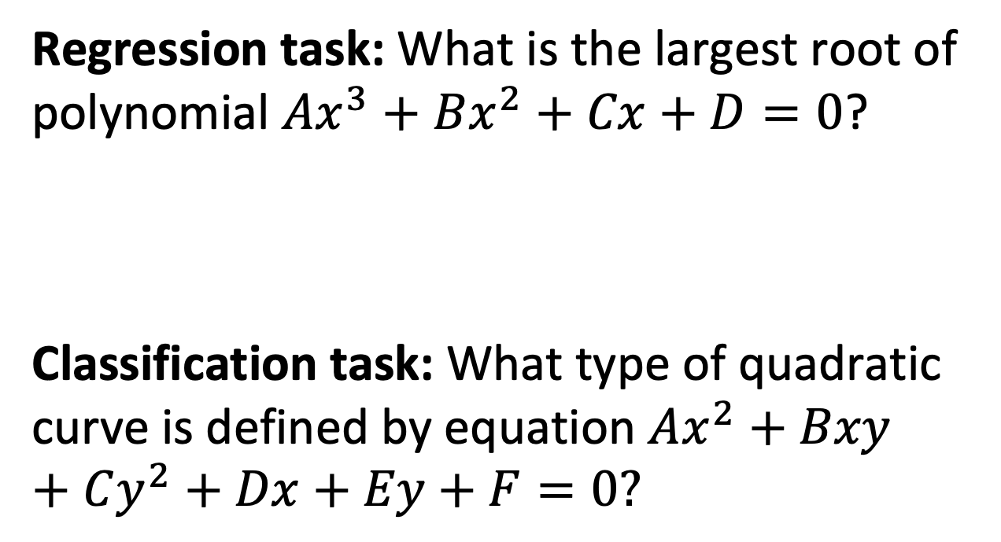
Regression and Classification
Regression task: What is the largest root of polynomial $Ax^{3}+Bx^{2}+Cx+D=0$?
Classification task: What type of quadratic curve is defined by equation $Ax^{2}+Bxy+Cy^{2}+Dx+Ey+F=0?$

Slide 6
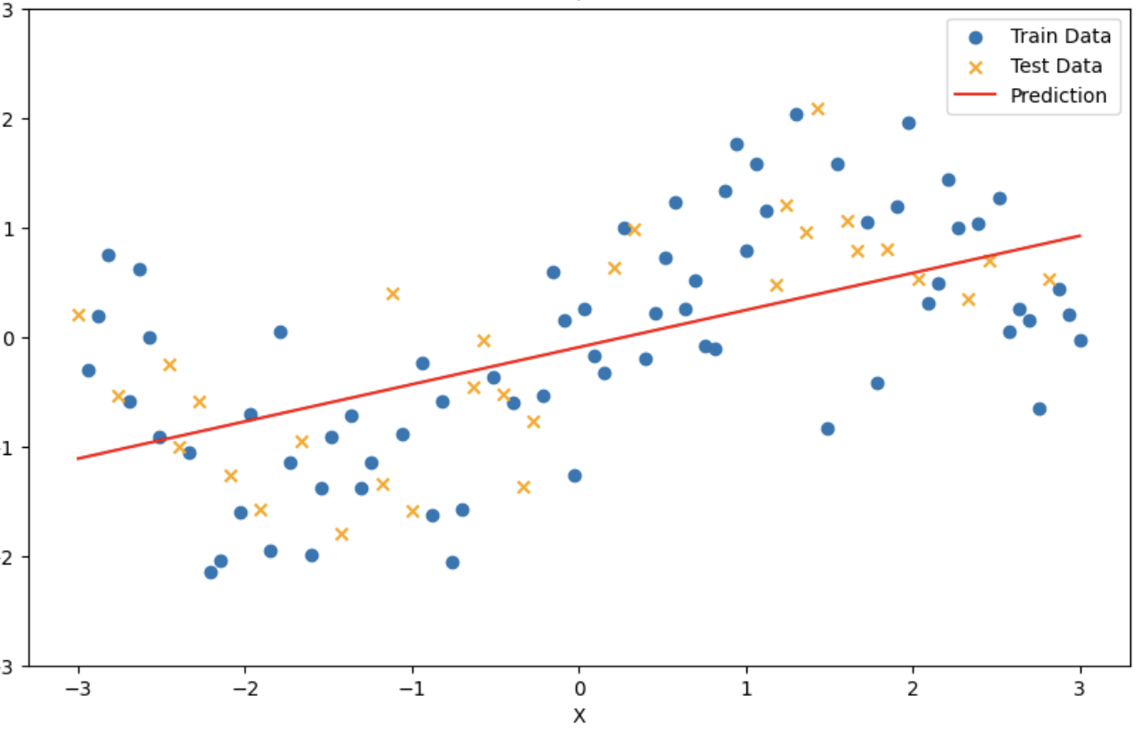
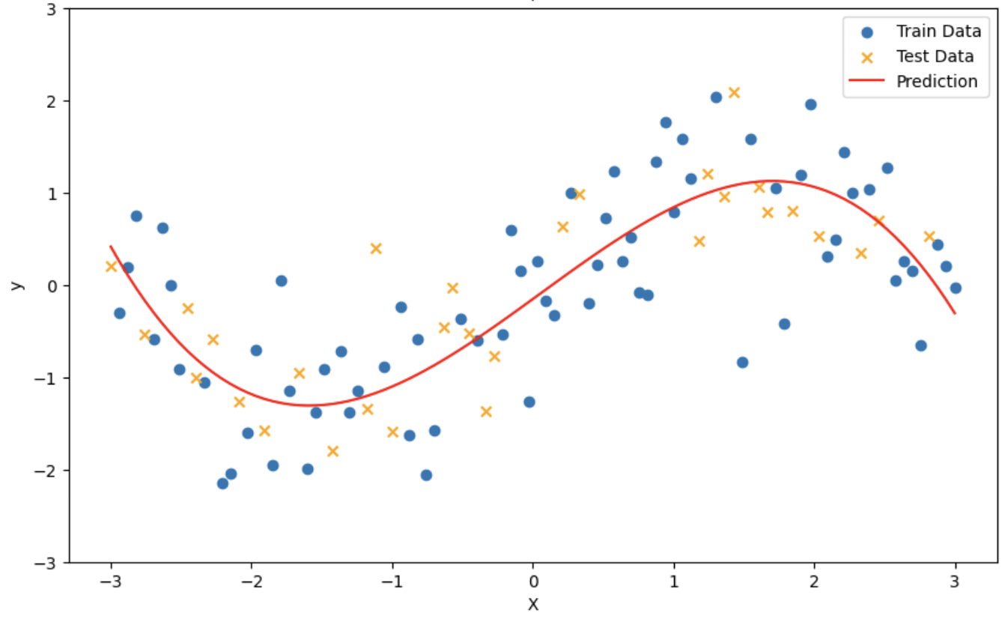
Regression

Slide 7
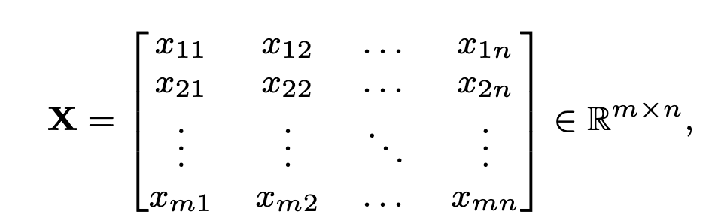
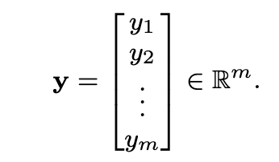
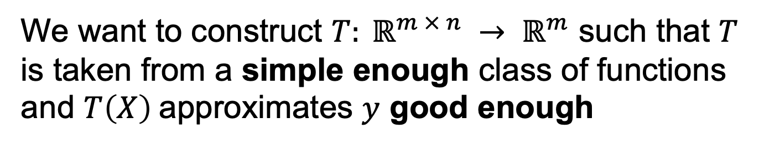
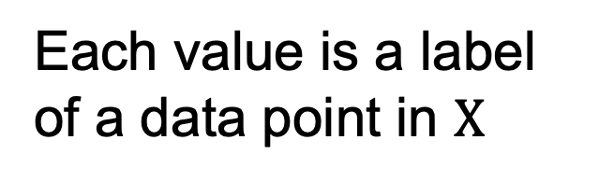
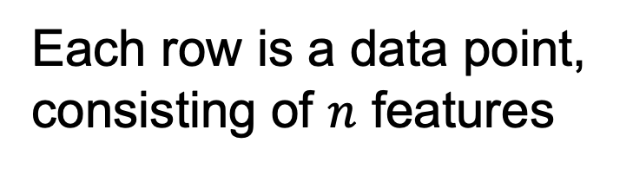
Formal setting
Each row is a data point, consisting of $n$ features
Each value is a label of a data point in $Χ$
We want to construct $T: ℝ^{m × n} → ℝ^{m}$ such that $T$ is taken from a simple enough class of functions and $T\left(X\right)$approximates $y$ good enough

Slide 8
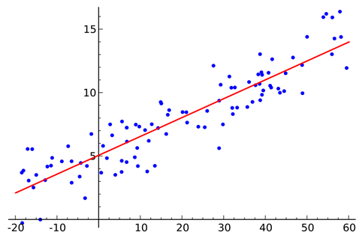
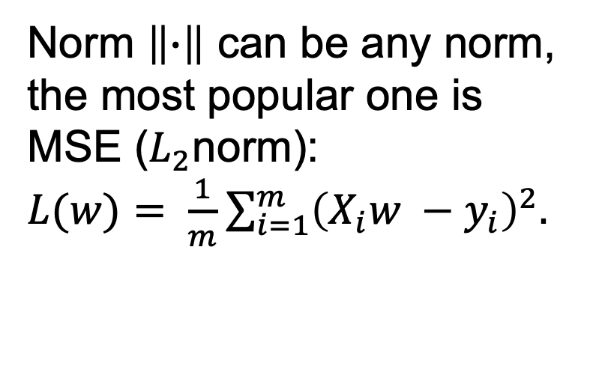
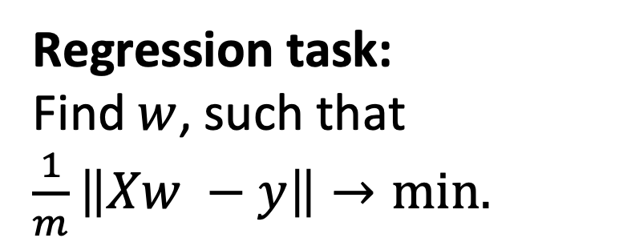
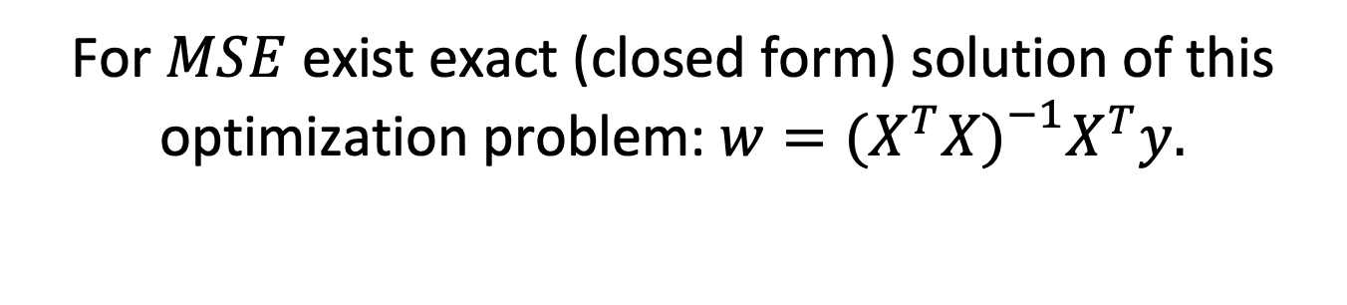
Linear Regression
Regression task: Find$w$, such that $\frac{1}{m}\left\|Xw −y\right\|→min.$
Norm $\left\|∙\right\|$ can be any norm, the most popular one is MSE ($L_{2}$norm):
$L(w)= \frac{1}{m}\sum_{i=1}^{m}{{\left(X_{i}w −y_{i}\right)}^{2}.}$
For $MSE$ exist exact (closed form) solution of this optimization problem: $w={(X^{T}X)}^{\begin{aligned}−1 \\ \end{aligned}}X^{T}y.$

Slide 9
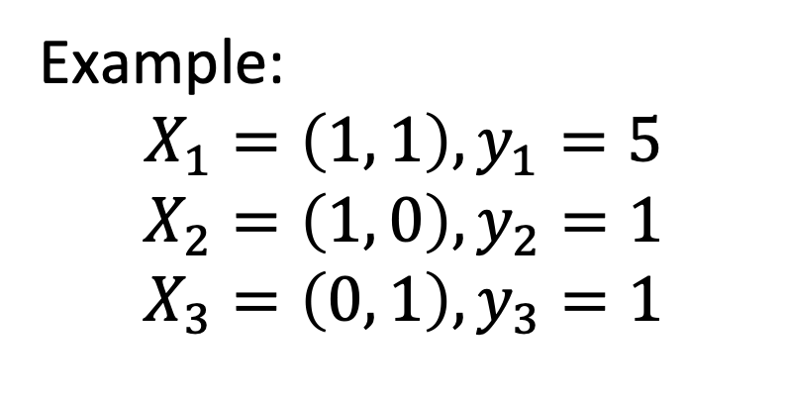

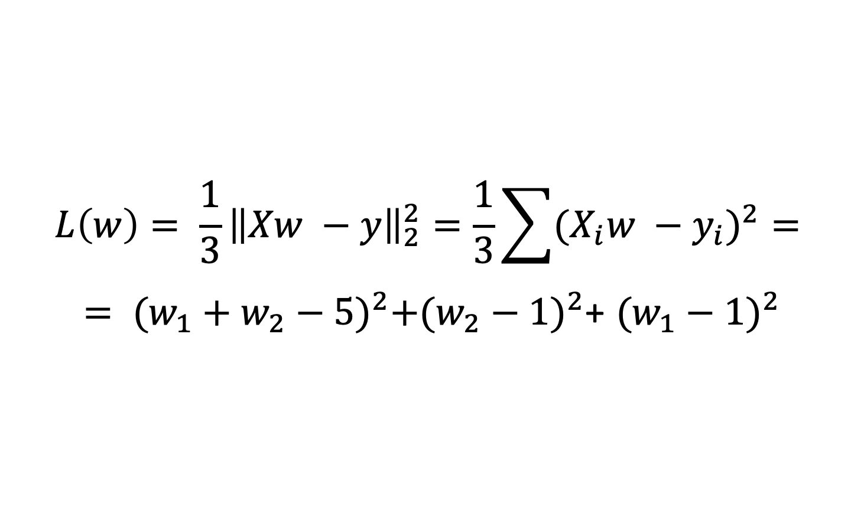
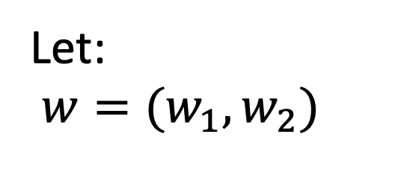
Linear regression
Example: $$X_{1}=\left(1, 1\right), y_{1}=5$$
$$X_{2}=\left(1, 0\right), y_{2}=1$$
$$X_{3}=\left(0, 1\right), y_{3}=1$$
Let:
$w=(w_{1},w_{2})$
$$L\left(w\right)= {\frac{1}{3}\left\|Xw −y\right\|}_{2}^{2}=\frac{1}{3}\sum{{{(X}_{i}w −y_{i})}^{2}= }$$
$= {(w_{1}+w_{2}−5)}^{2}+{(w_{2}−1)}^{2}$+ ${(w_{1}−1)}^{2}$
What is an optimal $w$?

Slide 10
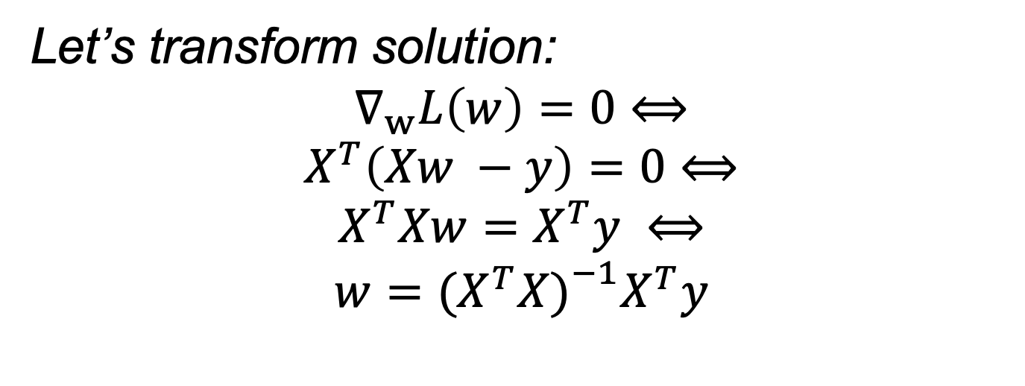
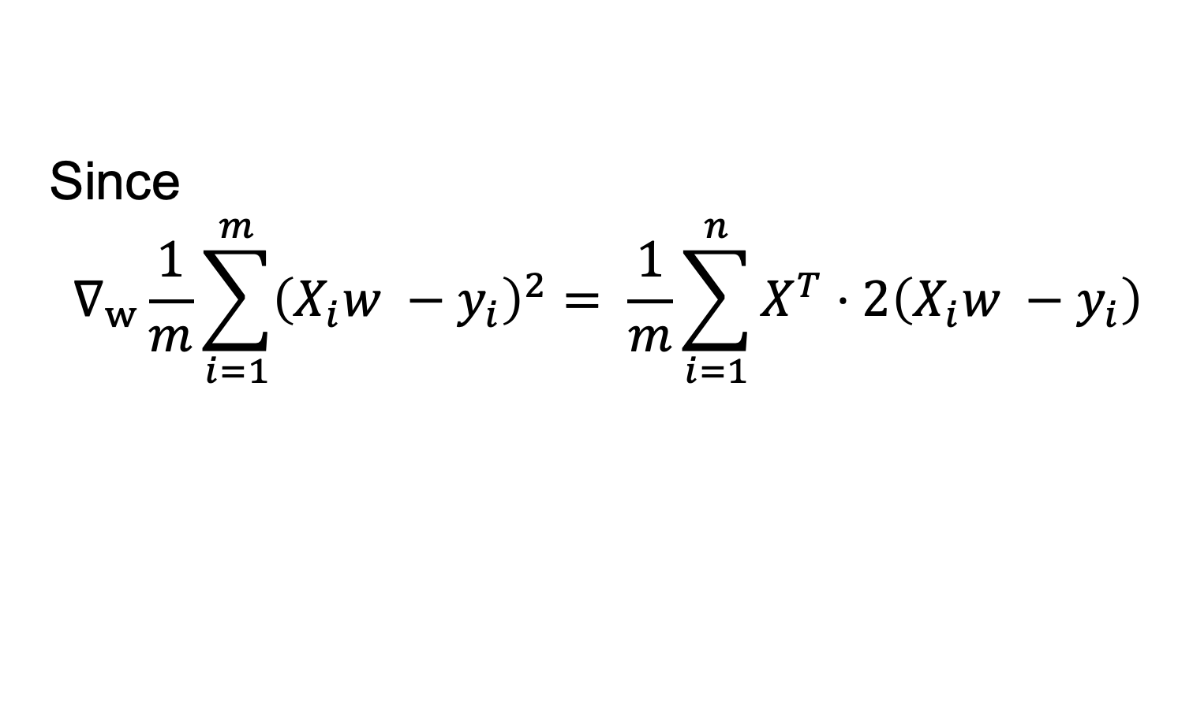
Linear regression
Let’s transform solution:
$$∇_{w}L\left(w\right)=0⟺$$
$$X^{T}\left(Xw −y\right)=0⟺$$
$$X^{T}Xw=X^{T}y ⟺$$
$$w={(X^{T}X)}^{\begin{aligned}−1 \\ \end{aligned}}X^{T}y$$
Since
$$∇_{w}\frac{1}{m}\sum_{i=1}^{m}{{\left(X_{i}w −y_{i}\right)}^{2}= \frac{1}{m}\sum_{i=1}^{n}{X^{T}⋅2\left(X_{i}w −y_{i}\right)}}$$

Slide 11
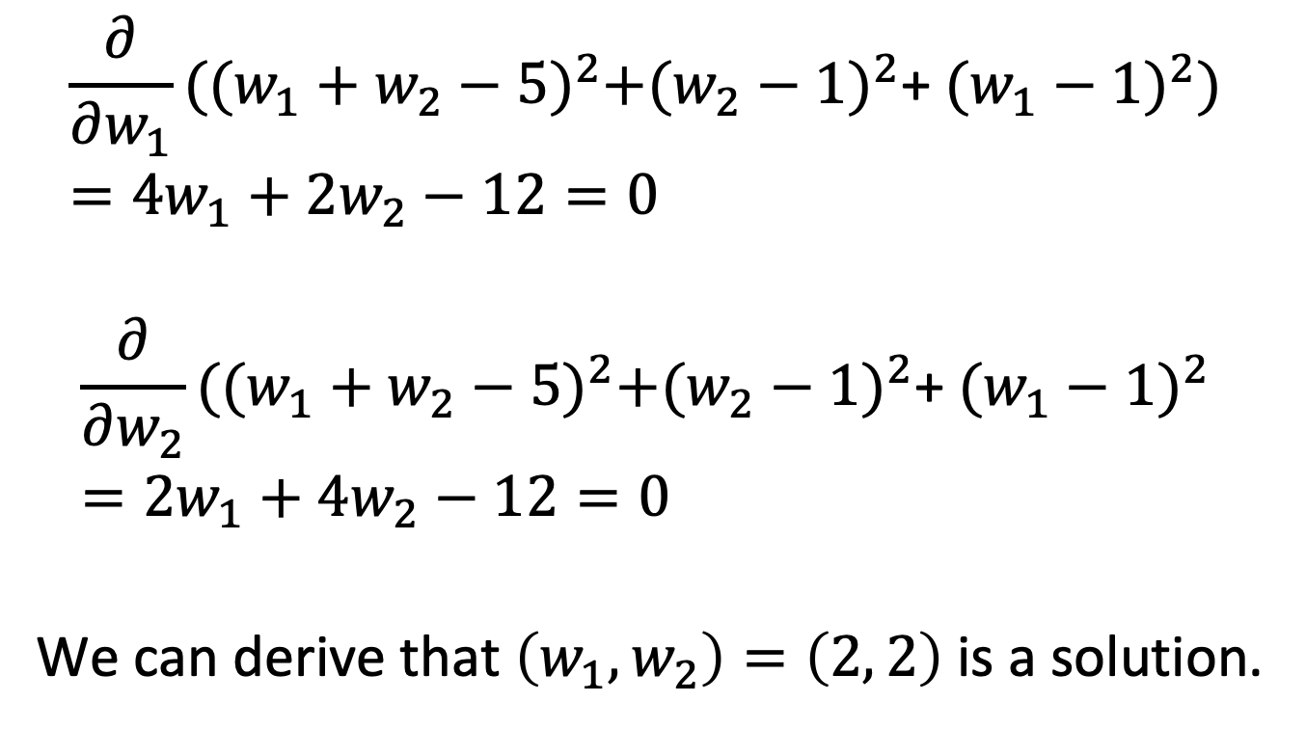
Linear regression
$$\frac{∂}{∂w_{1}}{((w_{1}+w_{2}−5)}^{2}+{(w_{2}−1)}^{2}\text{+ }{(w_{1}−1)}^{2})=4w_{1}+2w_{2}−12=0$$
$$\frac{∂}{∂w_{2}}{((w_{1}+w_{2}−5)}^{2}+{(w_{2}−1)}^{2}\text{+ }{(w_{1}−1)}^{2}=2w_{1}+4w_{2}−12=0$$
We can derive that $\left(w_{1},w_{2}\right)=\left(2, 2\right)$is a solution.

Slide 12
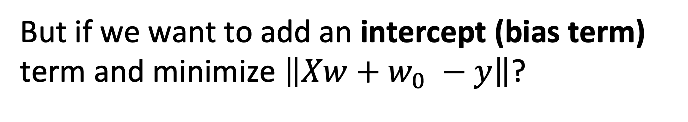
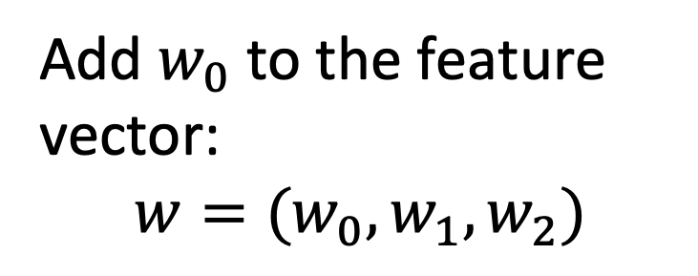
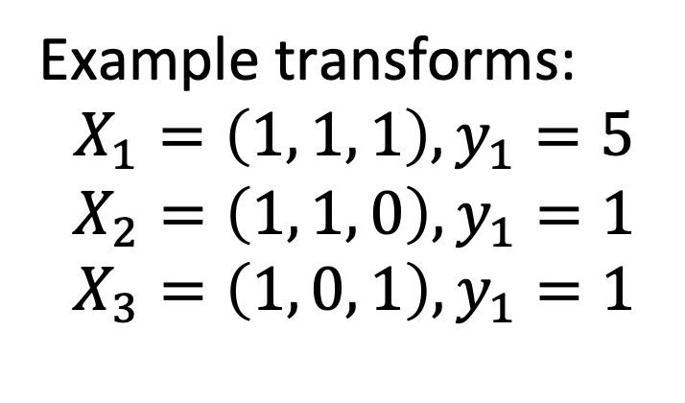
Linear regression
But if we want to add an intercept (bias term) term and minimize $\left\|Xw+w_{0} −y\right\|$?
Example transforms: $$X_{1}=\left(1, 1, 1\right), y_{1}=5$$
$$X_{2}=\left(1, 1, 0\right), y_{1}=1$$
$$X_{3}=\left(1, 0, 1\right), y_{1}=1$$
Add $w_{0}$ to the feature vector:
$$w=(w_{0}, w_{1},w_{2})$$
Constant feature
Original features

Slide 13
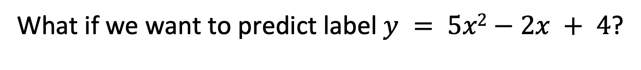
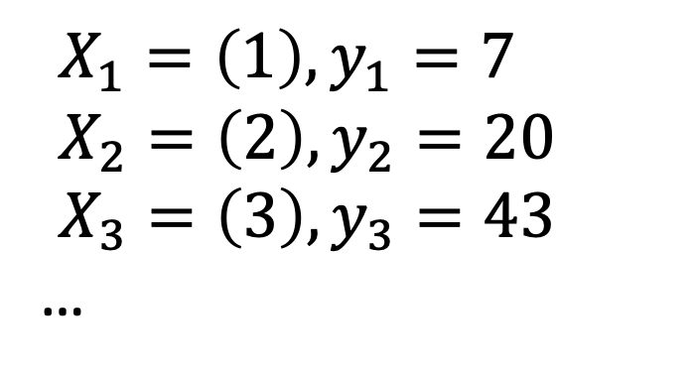
Linear regression
What if we want to predict label $y = 5x2−2x + 4$?
$X_{1}=\left(1\right), y_{1}=7$
$X_{2}=\left(2\right), y_{2}=20$
$X_{3}=\left(3\right), y_{3}=43$
…
If we just train linear regression, we can not obtain this dependency.

Slide 14
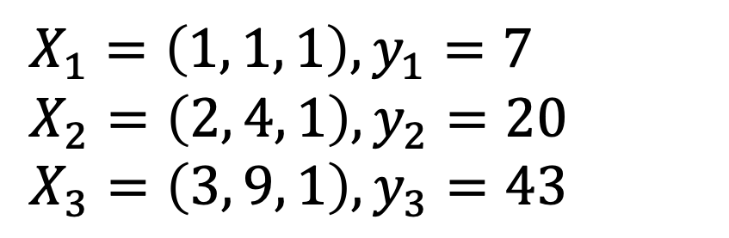
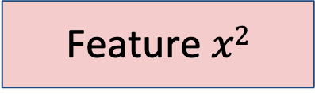
Adding features
But we can train linear regression with additional features − polynomial regression.
Original feature
Feature $x2$
Constant feature
$X_{1}=\left(1, 1, 1\right), y_{1}=7$
$X_{2}=\left(2, 4, 1\right), y_{2}=20$
$X_{3}=\left(3, 9, 1\right), y_{3}=43$

Slide 15

It’s tempting to think

Slide 16
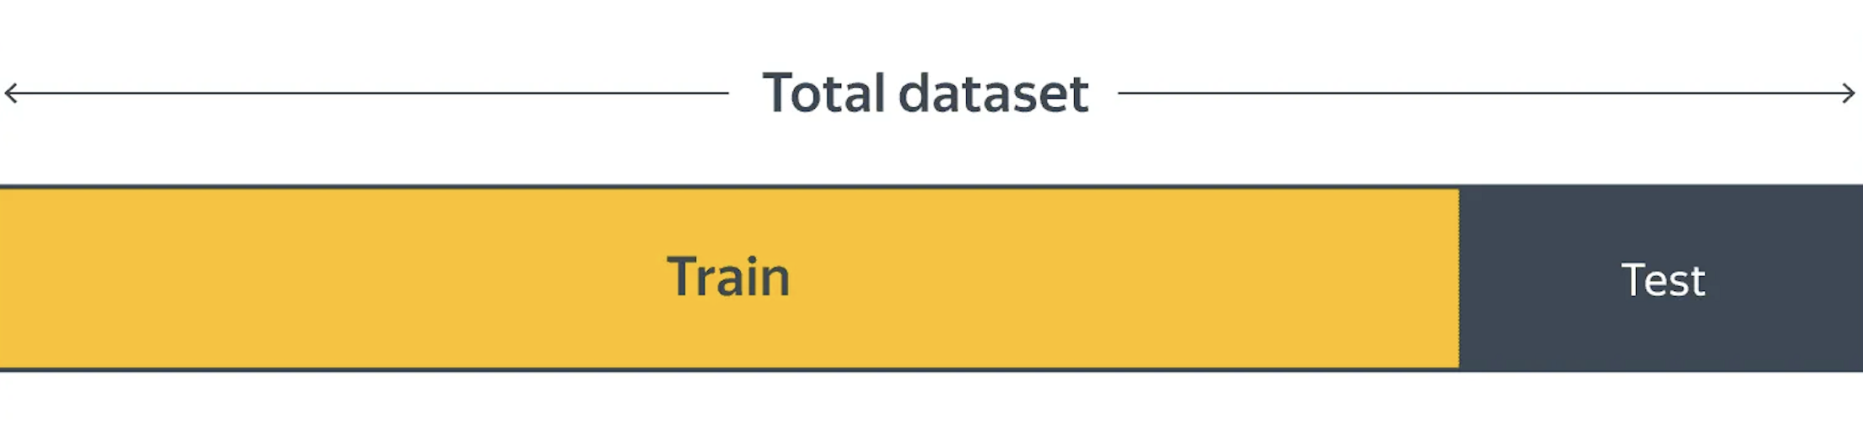
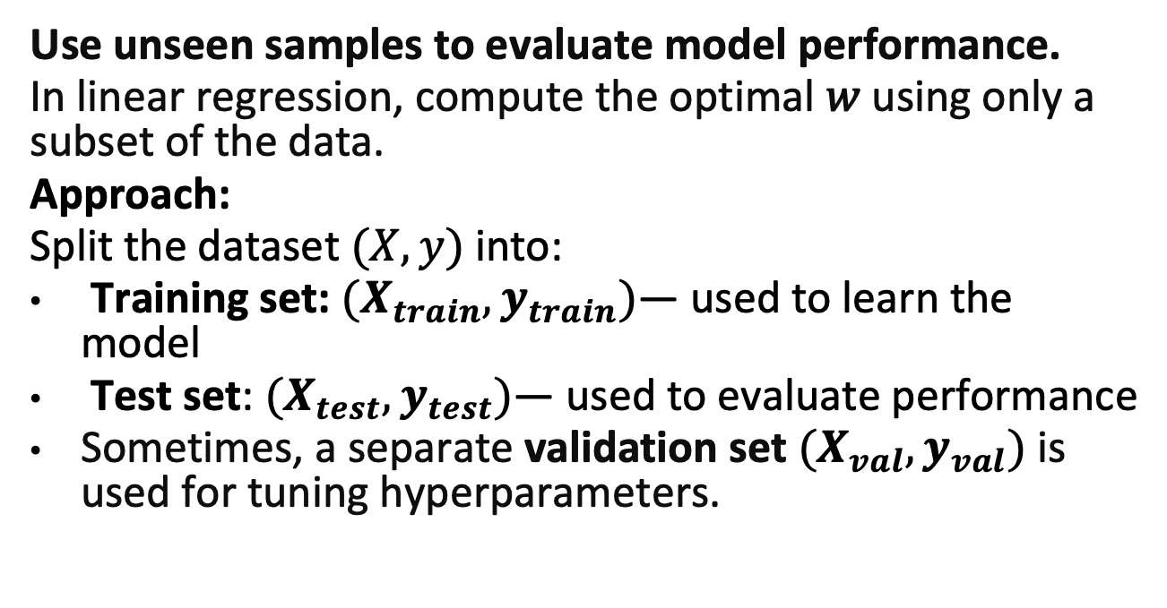
Evaluating Model Performance
Use unseen samples to evaluate model performance.
In linear regression, compute the optimal 𝑤 using only a subset of the data.
Approach:
Split the dataset $(X, y)$into:
Training set: $(X_{train}, y_{train})$— used to learn the model
Test set: $(X_{test}, y_{test})$— used to evaluate performance
Sometimes, a separate validation set $(X_{val}, y_{val})$ is used for tuning hyperparameters.

Slide 17
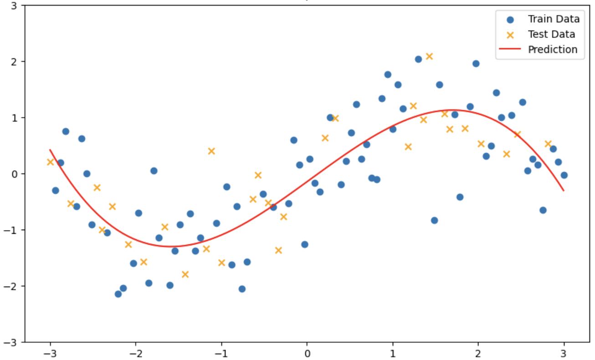
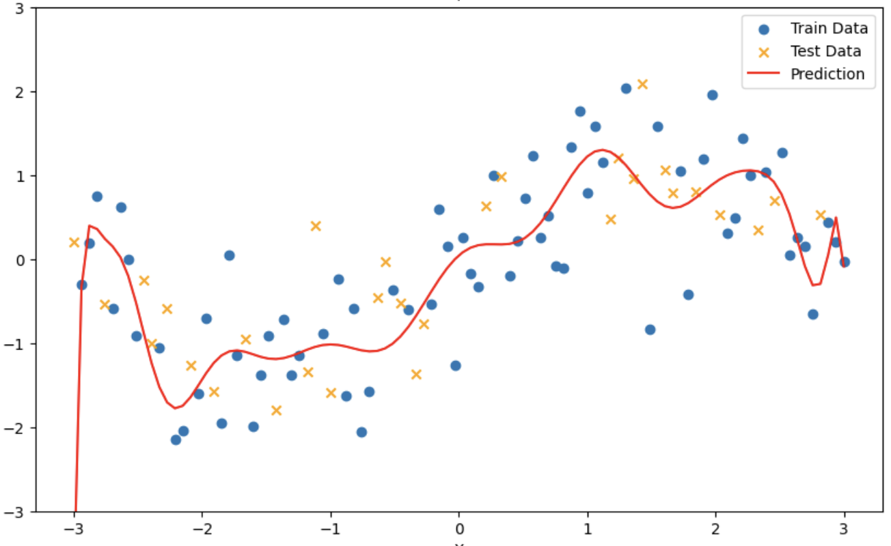
Regression on original dataset
Added powers ≤3
Added powers ≤18

Slide 18
Underfitted
Properly fitted
Overfitted

Slide 19
Underfitted
Main indicator:
Doesn’t capture the pattern
Huge error on training dataset
Solutions:
Increase model complexity
Add more features
Reduce regularization*
Improve optimization technique

Slide 20
Overfitted
Main indicator:
Learns noise patterns. Difference in error between train and test datasets.
Solutions:
Reduce model complexity
Use regularization*
Increase training data
Select better features
Improve optimization technique

Slide 21
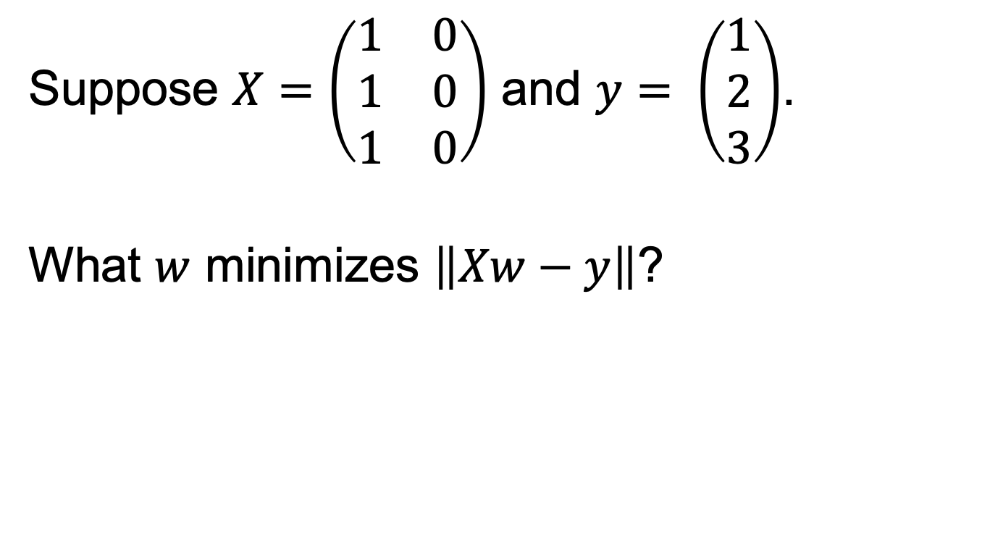
Multicollinearity
Suppose $X=\left(\begin{matrix}1 & 0 \\ 1 & 0 \\ 1 & 0\end{matrix}\right)$ and $y= \left(\begin{matrix}1 \\ 2 \\ 3\end{matrix}\right)$.
What $w$ minimizes $\left\|Xw−y\right\|$?

Slide 22

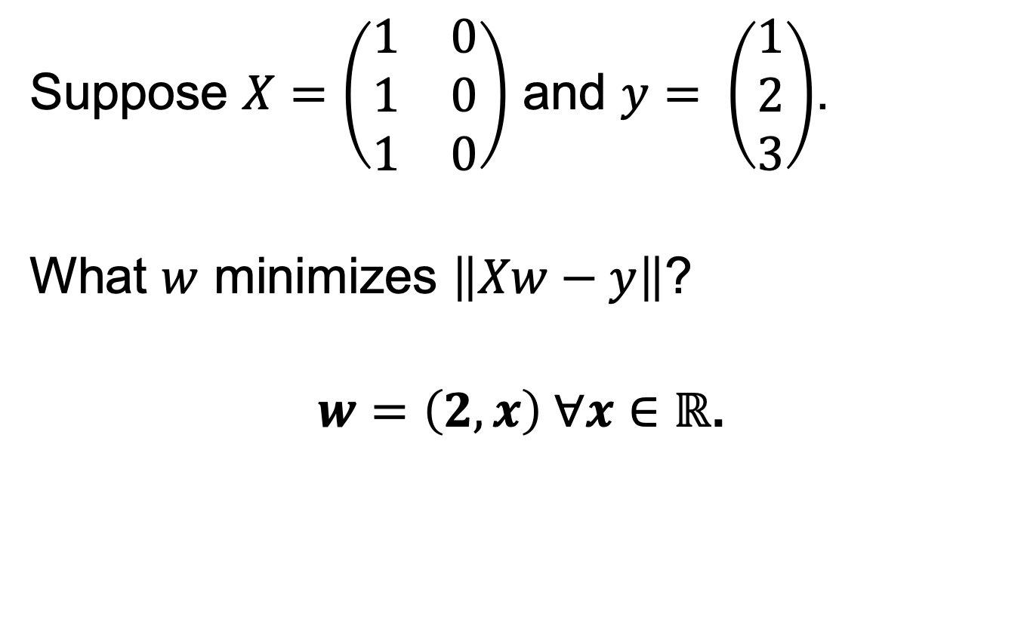
Multicollinearity
Suppose $X=\left(\begin{matrix}1 & 0 \\ 1 & 0 \\ 1 & 0\end{matrix}\right)$ and $y= \left(\begin{matrix}1 \\ 2 \\ 3\end{matrix}\right)$.
What $w$ minimizes $\left\|Xw−y\right\|$?
$w=\left(2, x\right) ∀x∈ℝ$.
$X^{T}X=\left(\begin{matrix}3 & 0 \\ 0 & 0\end{matrix}\right).$ $w={\left(X^{T}X\right)}^{−1}X^{T}y$

Slide 23
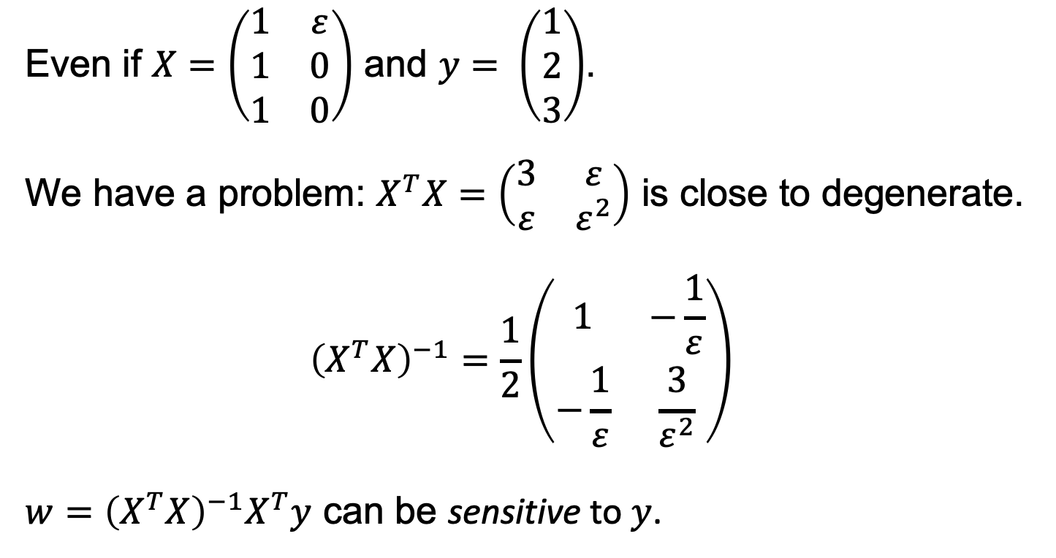
Multicollinearity
Even if $X=\left(\begin{matrix}1 & ε \\ 1 & 0 \\ 1 & 0\end{matrix}\right)$ and $y= \left(\begin{matrix}1 \\ 2 \\ 3\end{matrix}\right)$.
We have a problem: $X^{T}X=\left(\begin{matrix}3 & ε \\ ε & ε^{2}\end{matrix}\right)$ is close to degenerate.
$${\left(X^{T}X\right)}^{−1}=\frac{1}{2}\left(\begin{matrix}1 & −\frac{1}{ε} \\ −\frac{1}{ε} & \frac{3}{ε^{2}}\end{matrix}\right)$$
$w={\left(X^{T}X\right)}^{−1}X^{T}y$ can be sensitive to $y$.

Slide 24
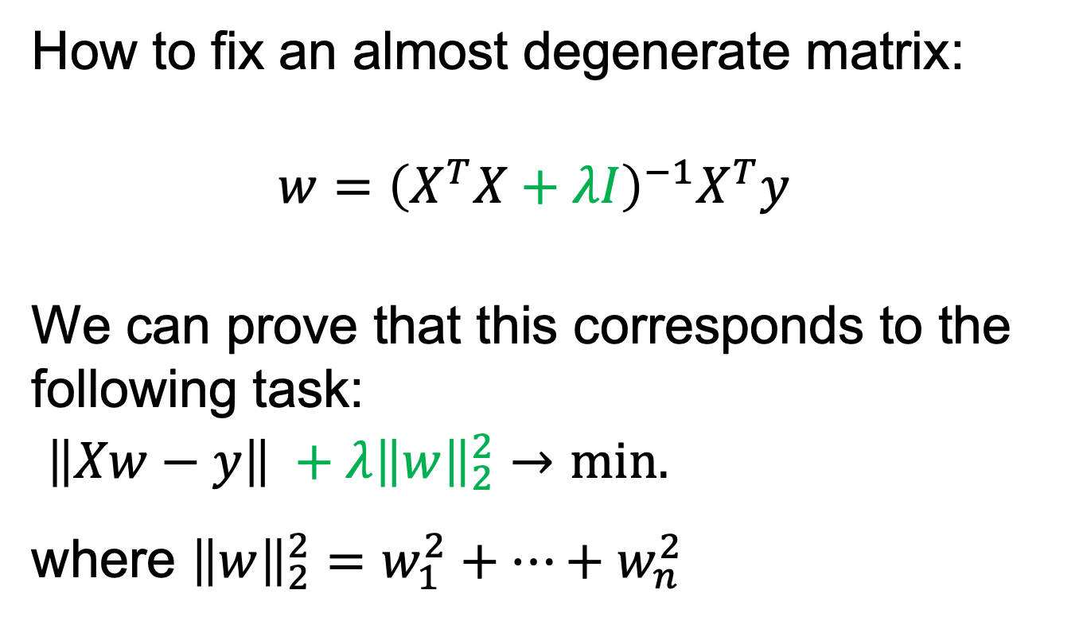
Multicollinearity
How to fix an almost degenerate matrix:
$$w={\left(X^{T}X+λI\right)}^{−1}X^{T}y$$
We can prove that this corresponds to the following task:
$\left\|Xw−y\right\| +λ{\left\|w\right\|}_{2}^{2}→min.$
where ${\left\|w\right\|}_{2}^{2}=w_{1}^{2}+…+w_{n}^{2}$

Slide 25
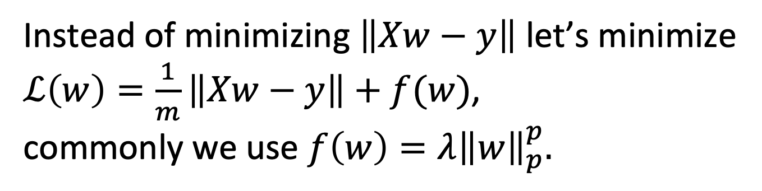
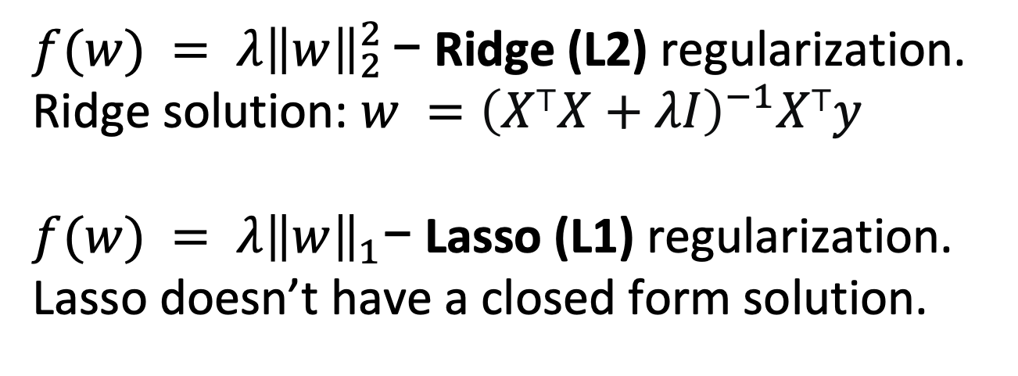
Regularization
Instead of minimizing $\left\|Xw−y\right\|$ let’s minimize $ℒ\left(w\right)=\frac{1}{m}\left\|Xw−y\right\|+f(w)$,
commonly we use $f\left(w\right)=λ{\left\|w\right\|}_{p}^{p}.$
$f(w) = λ{\left\|w\right\|}_{2}^{2 }\text{−}$ Ridge (L2) regularization.
Ridge solution: $w ={\left(X⊤X+λI\right)}^{−1}X⊤y$
$f(w) = λ{\left\|w\right\|}_{1}\text{−}$ Lasso (L1) regularization.
Lasso doesn’t have a closed form solution.

Slide 26
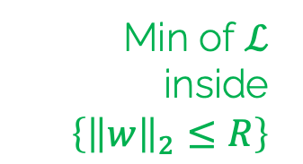

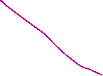

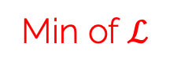


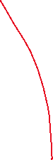

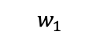


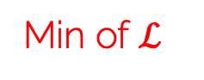
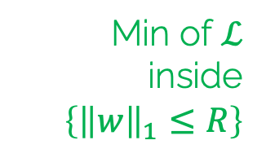


Compare: L1 vs L2
$ℒ$ contour lines
$ℒ$ contour lines
$$\left\{{\left\|w\right\|}_{2}≤R\right\}$$
$$w_{2}$$
$$w_{2}$$
$$\left\{{\left\|w\right\|}_{1}≤R\right\}$$
$$w_{1}$$
$$w_{1}$$
Min of $ℒ$ inside $\left\{{\left\|w\right\|}_{1}≤R\right\}$
Min of $ℒ$
Min of $ℒ$ inside $\left\{{\left\|w\right\|}_{2}≤R\right\}$
Min of $ℒ$

